Slide 1


Engineering Economics| ME 2001 | 3 Credits | 3 0 0 3
Lecture 3
Theory of demand and supply analysis

Slide 2
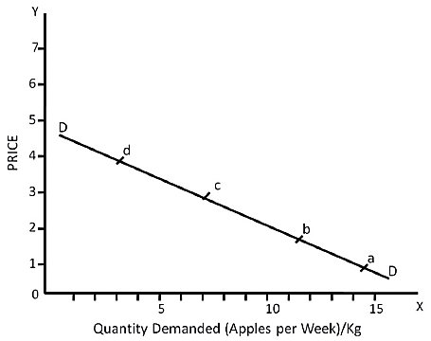
Law of Demand
Lecture 2
The inverse relationship between the quantity of a commodity and its price, given all other factors that influence the demand is called ‘law of demand’.
It gives us a demand curve that slopes downwards to the right. We can explain this idea with help of a demand schedule
Demand curve
The demand curve graphically shows the relationship between the quantity of a good that consumers are willing to buy and the price of the good.
Price of Apple per Kg. (in Rs.) | Quantity Demanded of Apples (in Kg. per week)
100 | 15
200 | 12
300 | 8
400 | 3

Slide 3
Why does a Demand Curve Slope Downwards?
Lecture 2
Substitution Effect: Substitution effect results from a change in the relative price of a commodity.
Suppose a Pepsi Can and a Coke Can both are priced at Rs. 90 and Rs. 20 each. If the price of Coke is raised to Rs. 25, and the price of Pepsi is not changed, Pepsi will become relatively cheaper to Coke, i.e. although the absolute price of Pepsi has not changed, the relative price of Pepsi has gone down.
The change in the relative price of commodity causes substitution effect.
Income Effect: This is the effect of a change in total purchasing power of the money income of the consumer.
As price of mango falls the purchasing power of the given money income rises, or his real income rises. Thus, he can buy more of the mangoes with the same money income.
His demand for any other commodities may also rise. This is called the ‘income effect’.
It is important to note that substitution effect and income effect operate simultaneously with the change in the price of the commodity.
‘Substitution effect’, and ‘income effect’ taken together give ‘price effect.’
Price Effect: Price Effect is the sum total of the substitution effect and income effect, i.e.
PE = SE + IE
Where PE = Price Effect.
SE = Substitution Effect
IE = Income Effect

Slide 4
CHANGE IN QUANTITY DEMANDED Vs. CHANGE IN DEMAND
When the demand for a commodity changes because of the change in its price, it is called ‘change in quantity demanded’. On the other hand, when the change in demand is due to the factors other than its price cause a change it is called ‘change in demand’.
Change in Demand
The shift of the demand curve to the right shows ‘increase in demand’ and a movement of the demand curve to the left of the initial demand curve is a ‘decrease in demand’.
Expansion and Contraction in Demand (Change in quantity demanded)

Slide 5
Concept of Supply
Lecture 2
Supply refers to the quantity of a commodity that producers are willing to sell at different prices per unit of time.
A higher price would mean more profits. The producer will supply more at a higher price.
Similarly, a producer will supply smaller quantity at a lower price.
This is a direct relationship between the price and the quantity supplied of a commodity and is called the ‘Law of Supply’.
A producer aims to maximize profits
Therefore, profit is estimated through difference between total revenue and total cost.
Total revenue is the price of the product multiplied by its quantity sold.
Total cost is the cost of production.
Profit = TR – TC
TR = Total Revenue (q.p)
TC = Total Cost (q.AC)
where AC is average cost.

Slide 6
Determinants of Supply
Lecture 2
Price of the commodity supplied
The price is most immediate determinant of supply.
A person or firm will make quick check whether the costs will be covered by the price. As the price goes up, a firm/person will be willing to sell larger quantity.
2. The prices of factors of production or cost of production
These affect the cost of production and possible profits of the firm. A rise in the prices of factors of production discourages the production and supply of the commodity.
3. Prices of other goods
As the prices of other commodities rise, they become more attractive to produce for a profit maximising firm. Hence supply of commodity whose price is unchanged will decline.

Slide 7
Determinants of Supply
Lecture 2
4. The state of technology
The improvement in the knowledge about the means and the methods of production lead to lower costs of production and helps increasing output.
5. Goals of the producer
The objective with which the producer undertakes production also influences his production and supply decisions.
Price (in Rs) per Pen | Quantity Supplied (in thousand per Month
2 | 25
3 | 40
4 | 50
5 | 60
6 | 70

Slide 8
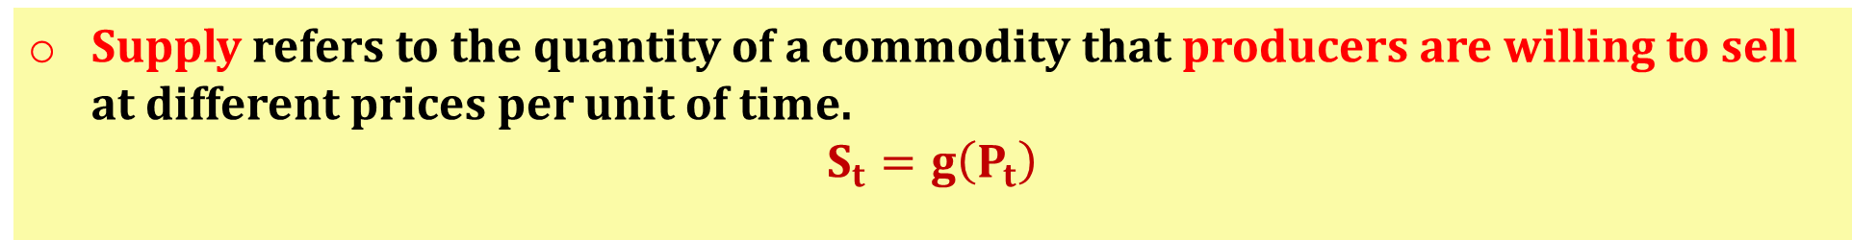
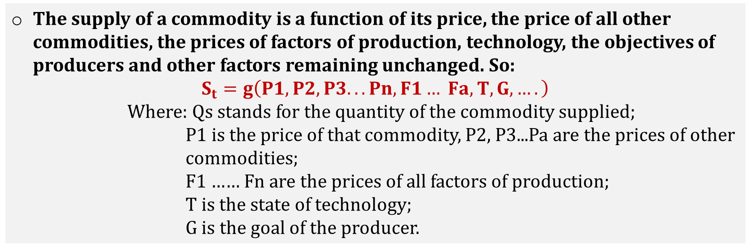
Concept of Supply
Lecture 2
Supply refers to the quantity of a commodity that producers are willing to sell at different prices per unit of time.
$$S_{t}=g\left(P_{t}\right)$$
The supply of a commodity is a function of its price, the price of all other commodities, the prices of factors of production, technology, the objectives of producers and other factors remaining unchanged. So:
$$S_{t}=g\left(P1, P2, P3... Pn, F1… Fa, T, G, ….\right)$$
Where: Qs stands for the quantity of the commodity supplied;
P1 is the price of that commodity, P2, P3...Pa are the prices of other
commodities;
F1 …… Fn are the prices of all factors of production;
T is the state of technology;
G is the goal of the producer.

